Slide 1
INTRODUCTION TO HTML/CSS
with Cezin Cupii

Slide 2
AGENDA
01
03
02
04
Introduction
CSS
HTML
Conclusion

Slide 3
—Alan Kay
“The most disastrous thing that you can ever learn is your first programming language.”

Slide 4
01
INTRODUCTION

Slide 5
Frequent interview questions
What’s the functionality of the „alt” attribute?
What’s the difference between div and span?
Name some HTML5 tags
How can you add CSS style?
What is the box-model?
How do you center an element ? (2 examples)

Slide 6
02
HTML

Slide 7

INTRO INTO HTML
What is HTML?
-HTML (Hyper Text Markup Language) – language for describing web pages
-NOT a programming languate, it is a markup language, a set of markup tags

Slide 8
HISTORY OF HTML
Table
Style
Script
HTML 2.0
HTML 4.0
1993
1995
1997
1999
2012
HTML 1.0
HTML 3.0
HTML 5.0
Heading
Paragraph
Anchor
List
Image
Audio
Video
Canvas
Notes:
Persoana care a inventat HTML-ul nu a fost un programator, ci un fizician care lucra la Organizatia Europeana pentru Cercetare Nucleara, Tim Berners-Lee pentru a crea o cale de comunicare pentru ca cercetatorii sa foloseasca internetul pentru a colabora si a face share de informatii

Slide 9
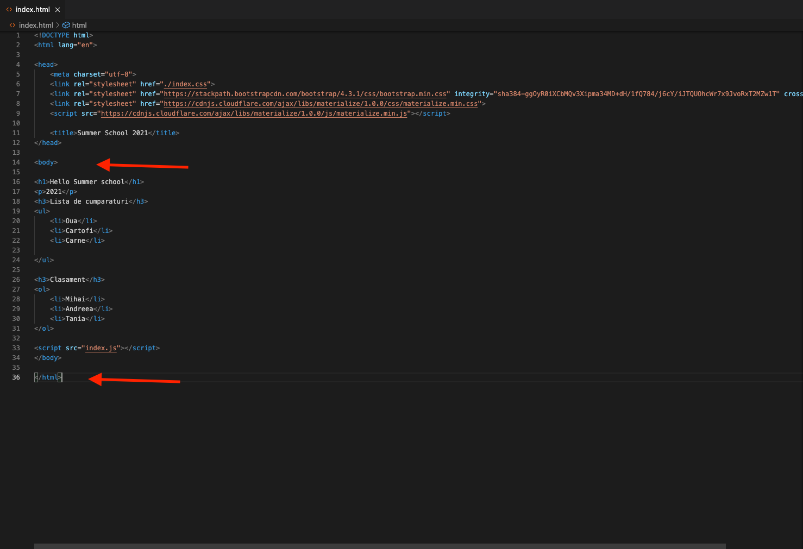
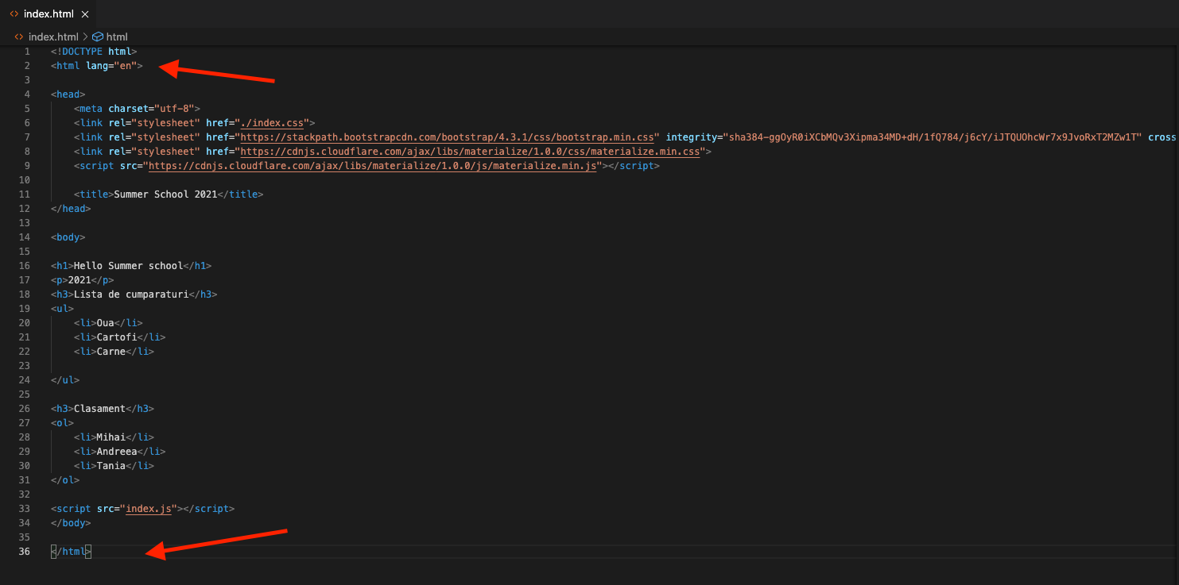
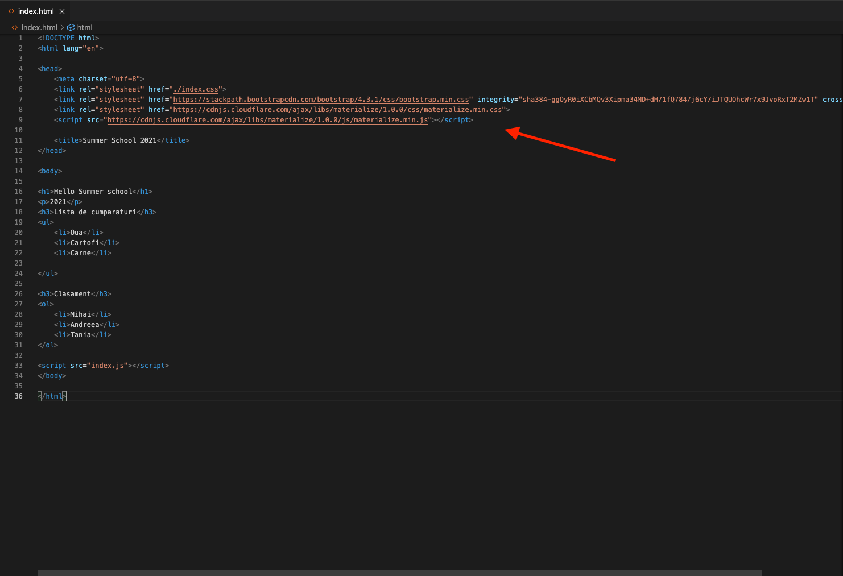
HTML PAGE STRUCTURE
<html> </html>
HTML
<head> </head>
<body> </body>
Wrapper for the whole content
Container for metadata
All visible elements on the page

Slide 10
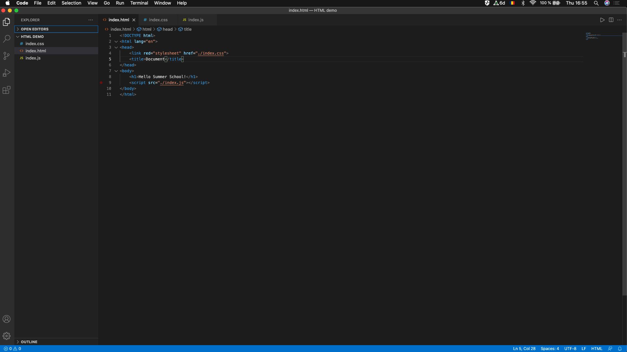
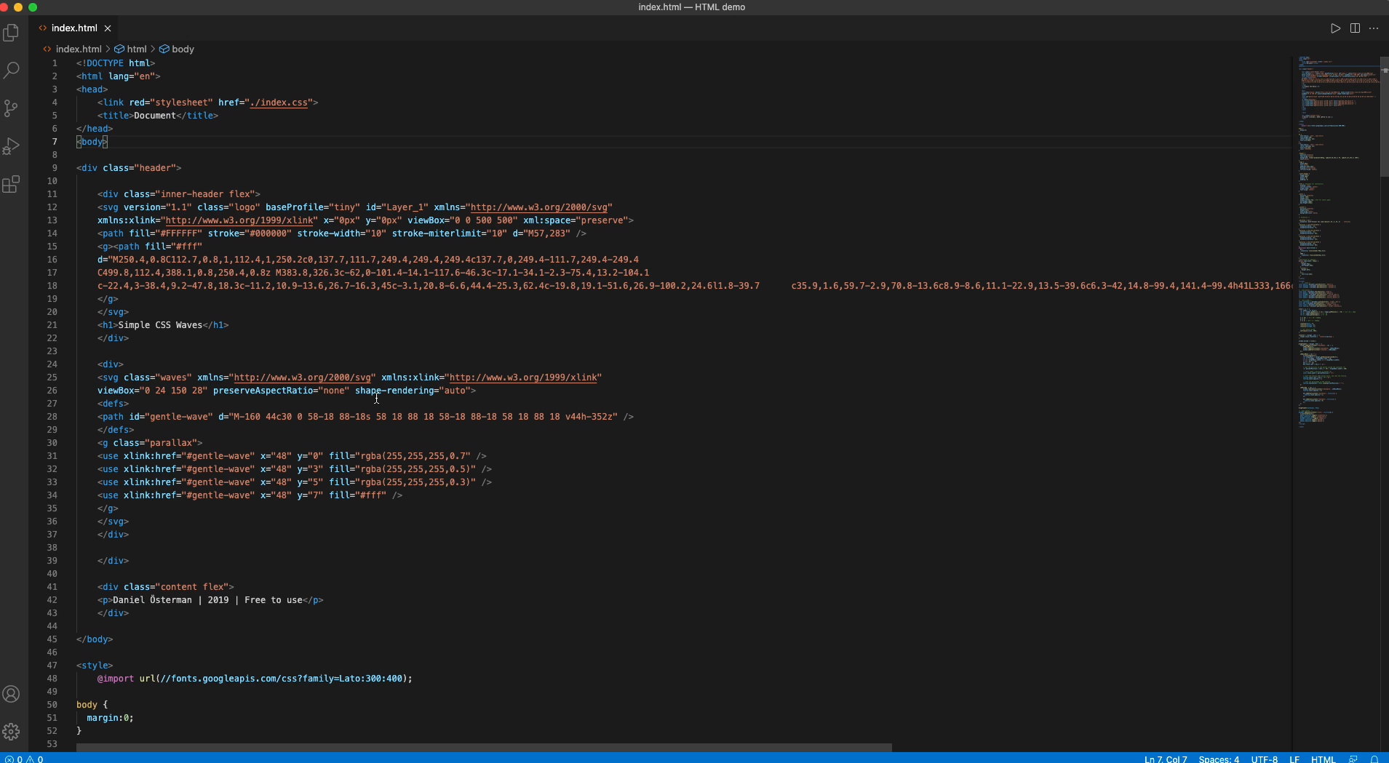
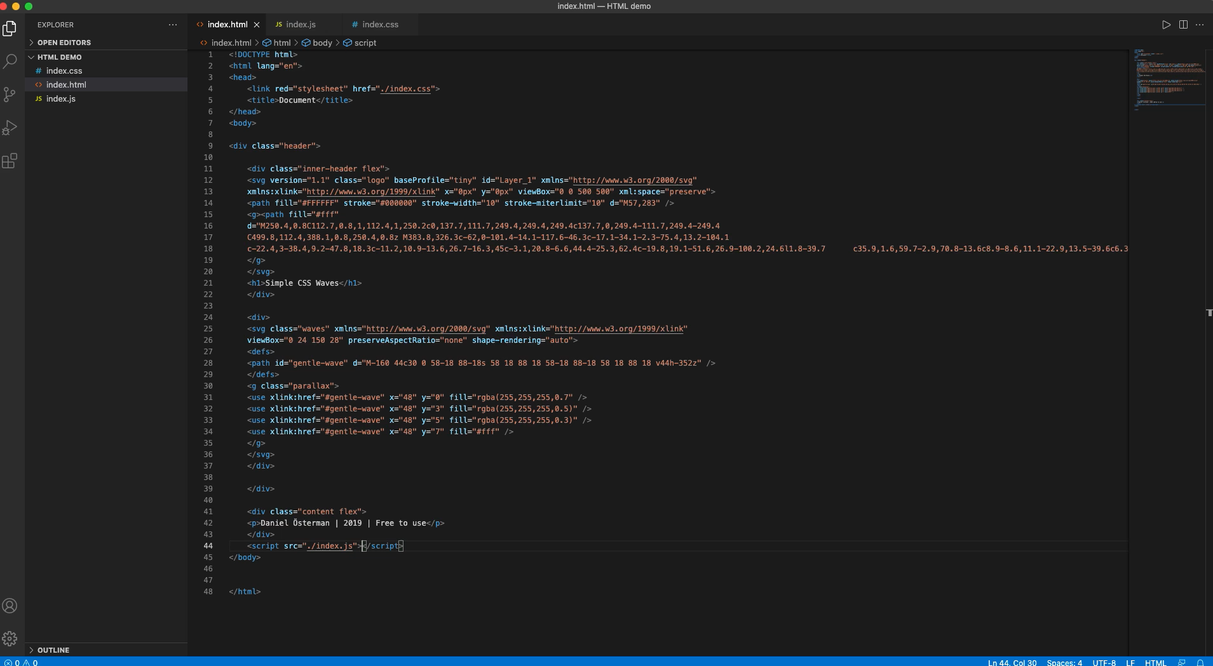
HOW WE STRUCTURE THE CODE?
1
2
Which variant is easier to read for someone else?

Slide 11
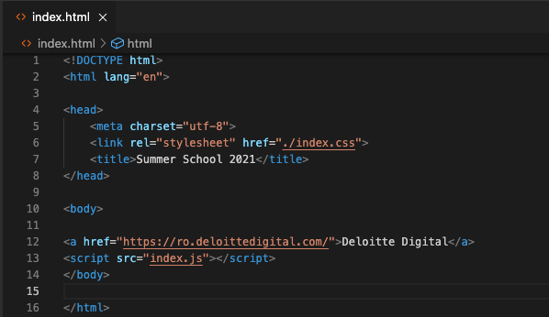
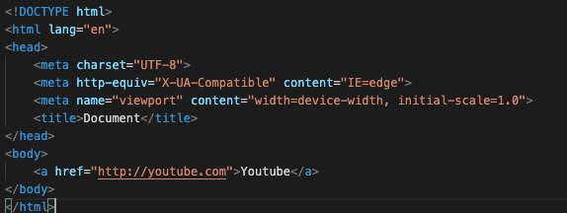
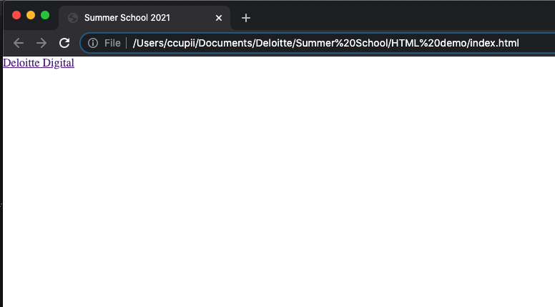
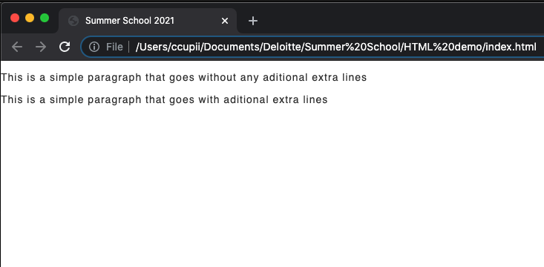
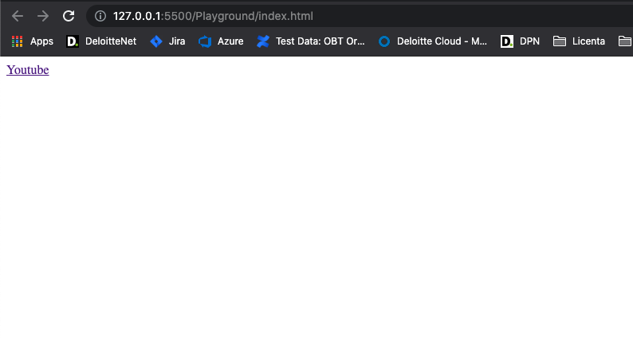
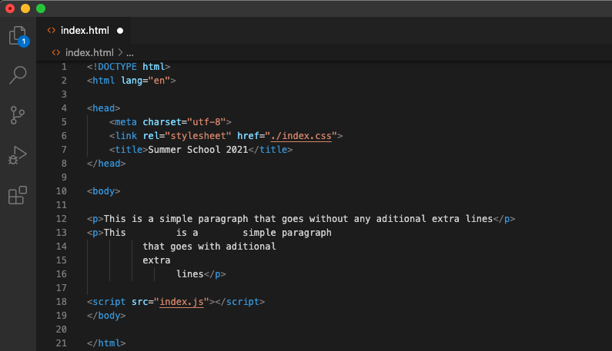
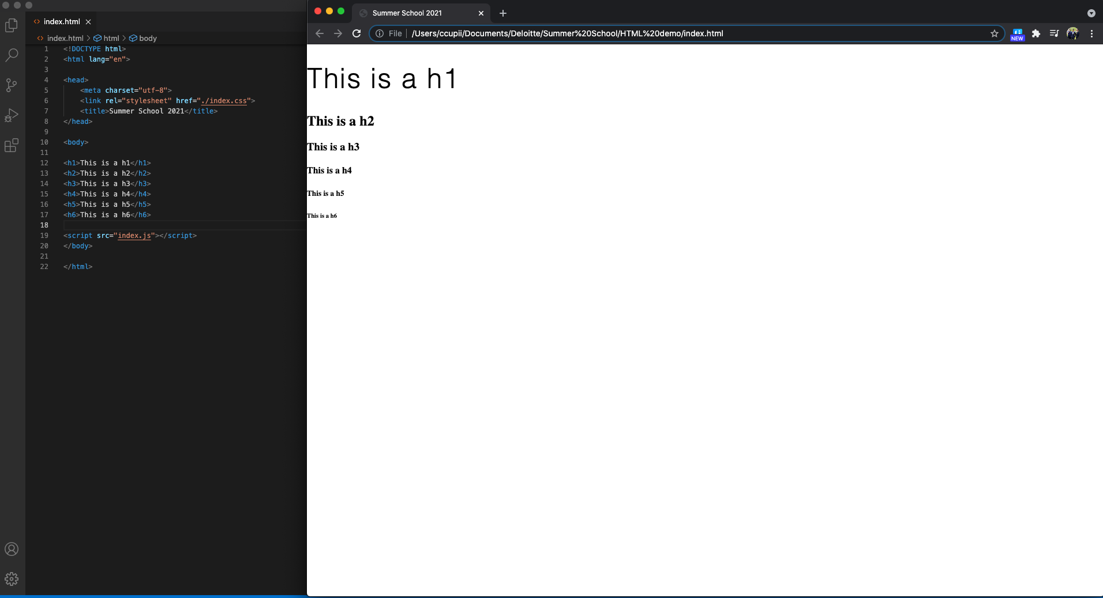
HTML TAGS
Headings
From <h1> to <h6> depending on size
We use them for heading, not for bold or BIG text
Used by the Google search engine
Paragraphs
<p> </p>
Always starts on new line
Ignores whitespaces
Links
<a> </a>
”href” attribute for providing the link to the address
Notes:
<h1> headings should be used for main headings, followed by <h2> headings, then the less important <h3>, and so on.

Slide 12
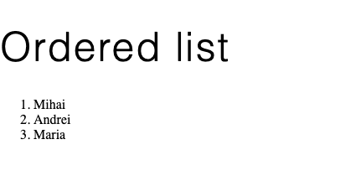
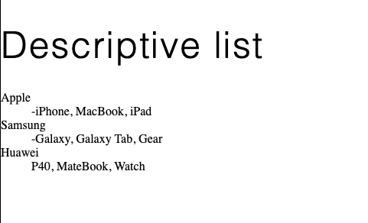
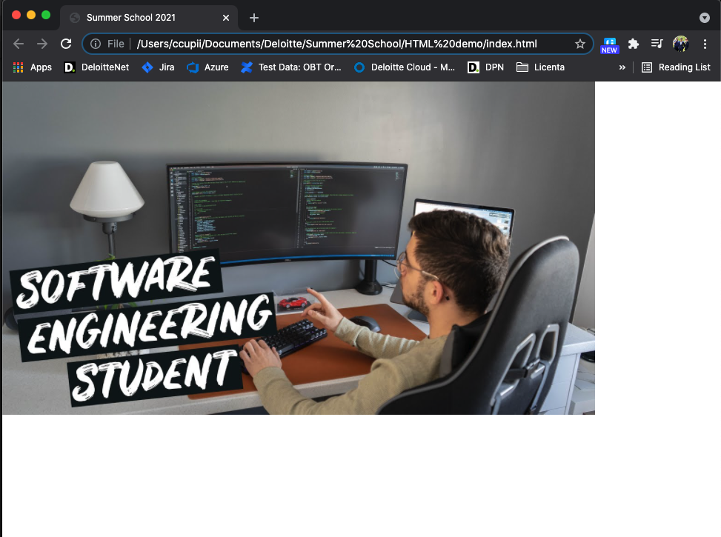
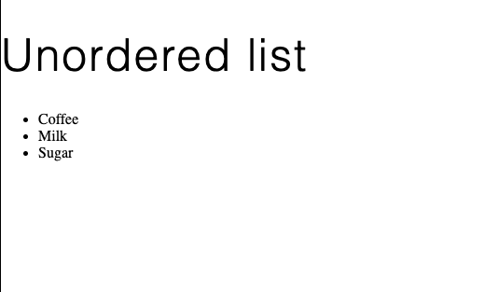
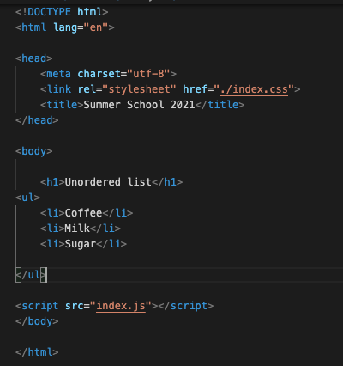
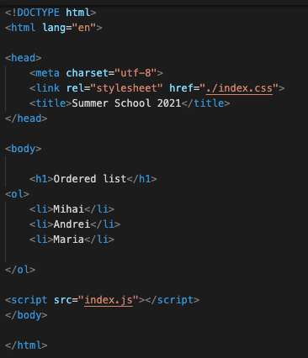
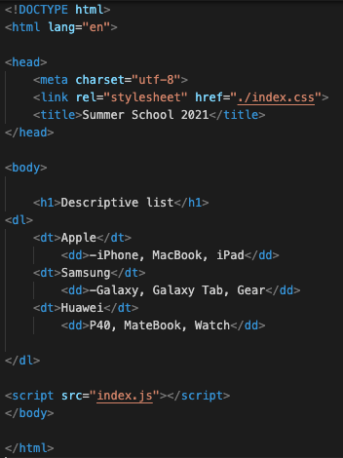
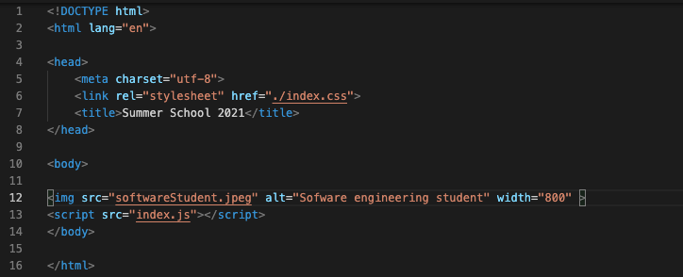
HTML TAGS #2
Images
<img>
Required attributes:
src
alt
Alternative text
Lists
Unordered list (<ul></ul)
Defines an unordered list
<li> </li>
Bullet point by default
Ordered list (<ol></ol>)
Defines an ordered list
<li></li>
Descriptive list (<dl></dl>)
It adds a description
<dt> - name
<dd> - description
Notes:
Atributul obligatoriu alt specifica un text alternativ pentru imagine, daca aveasta nu paote fi afisata in pagina

Slide 13
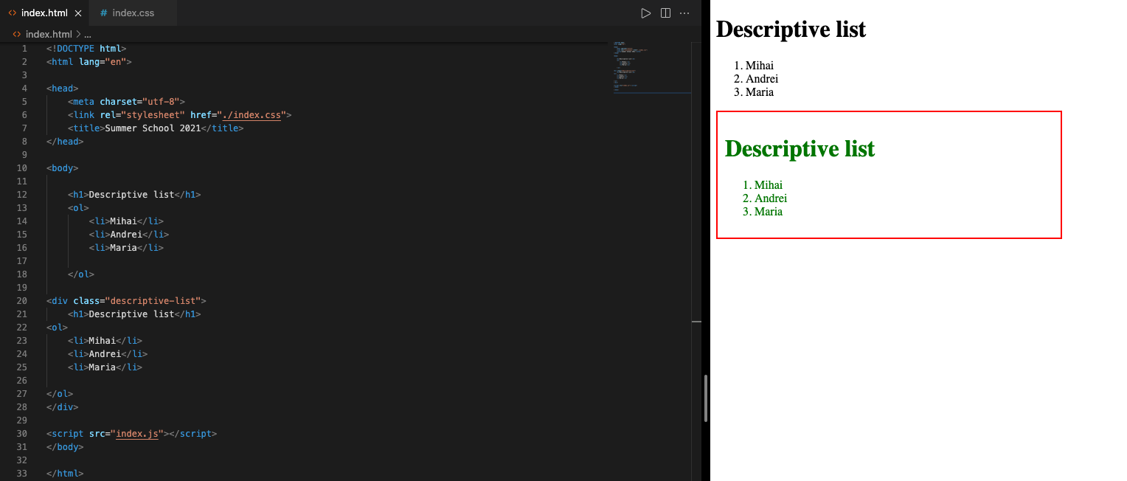
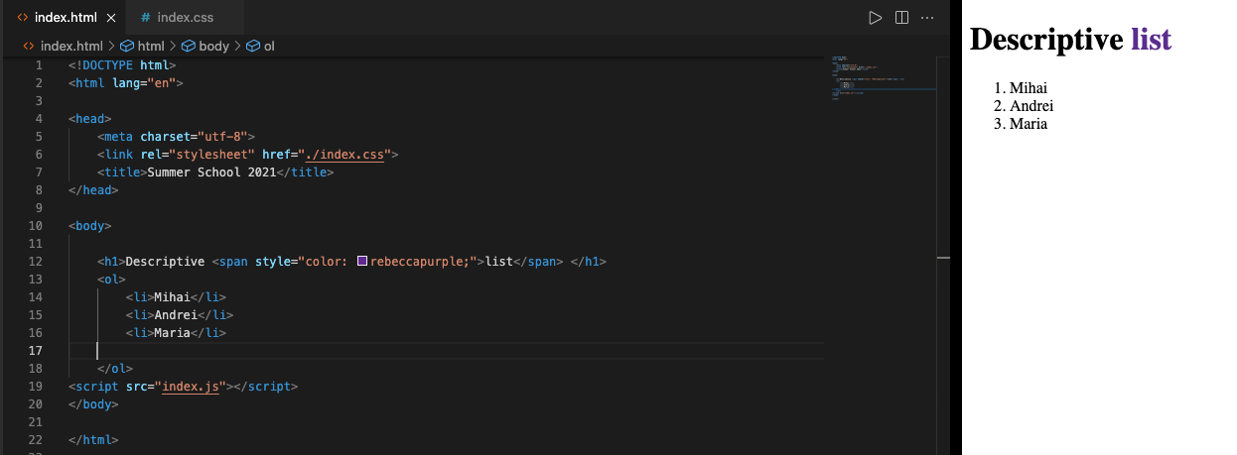
HTML TAGS #3
Div
Generic container for flow content
Display = block
No effect on the content if used plain
Span
Generic inline container for phrasing content
Display = inline
No effect on the content if used plain
WHAT’S THE DIFFERENCE?

Slide 14
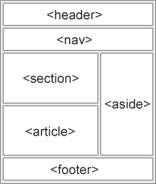
HTML 5.0 TAGS
<section>
Section in a document
<article>
Independent, self-contained text
<header>
Header for document or section
Should be used as a container for introductory content
NOT unique
<footer>
Footer for a document or section
NOT unique
<nav>
A set of navigation links
<aside>
Some content aside from the content it is placed in
Indirectly related to the surrounding content

Slide 15
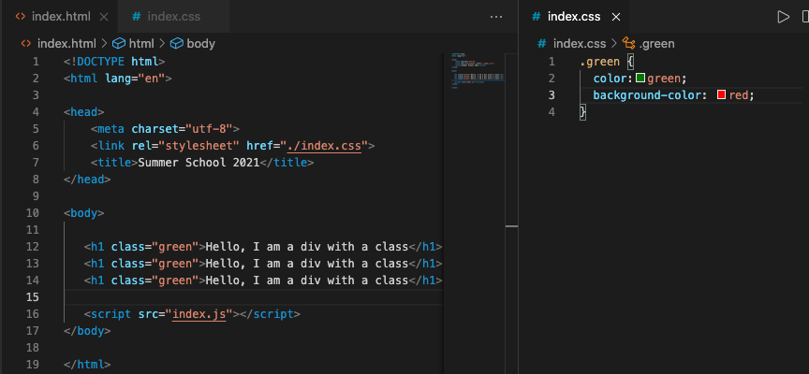
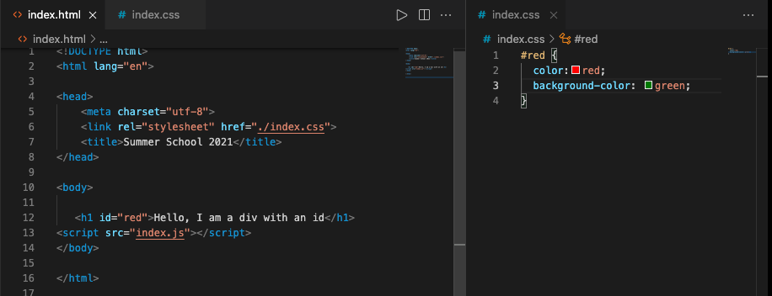
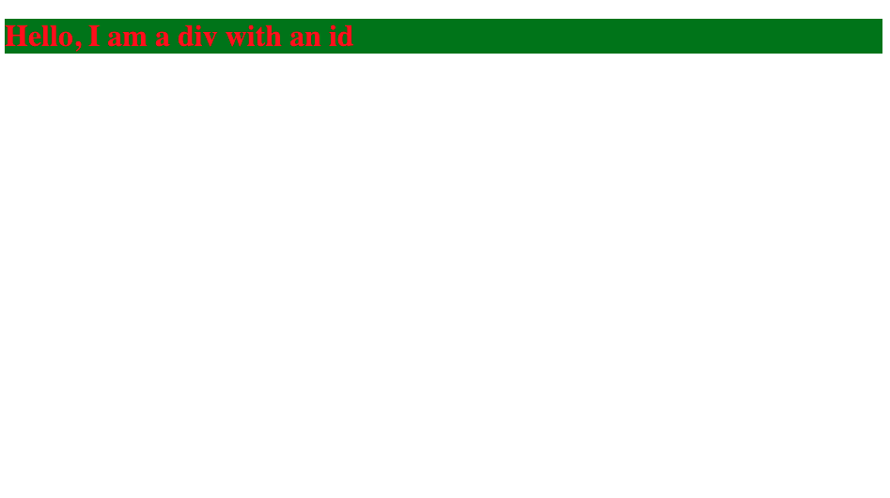
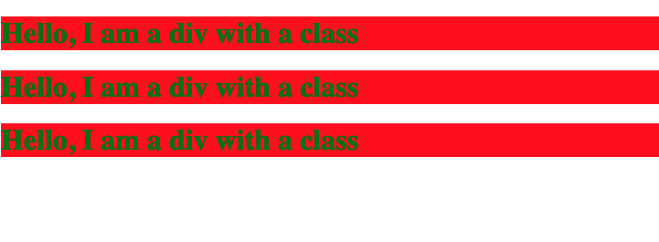
ID VS CLASS
Class
ID
-Unique identifier which is used to specify the document
- Used by CSS and JS to perform certain task for a unique element
-Attribute used to specify one or more class names for a HTML element
-Can be used by CSS and JS to perform certain tasks for these elements

Slide 16
W3Schools
DevDocs
LEARN MORE
https://www.w3schools.com
MDN
https://developer.mozilla.org/
https://devdocs.io/html/

Slide 17
03
CSS

Slide 18
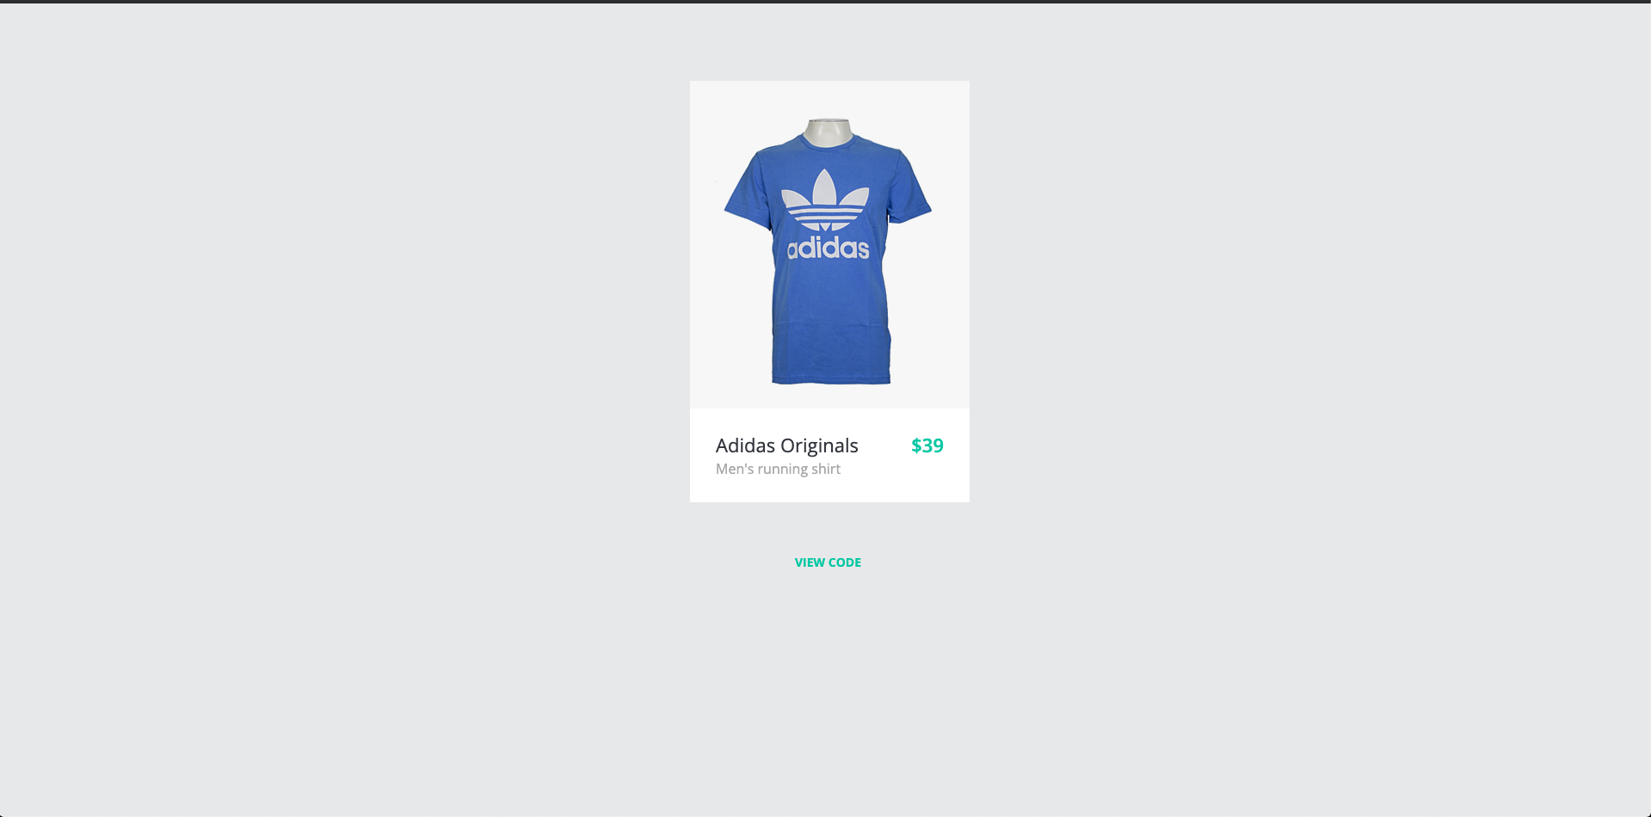
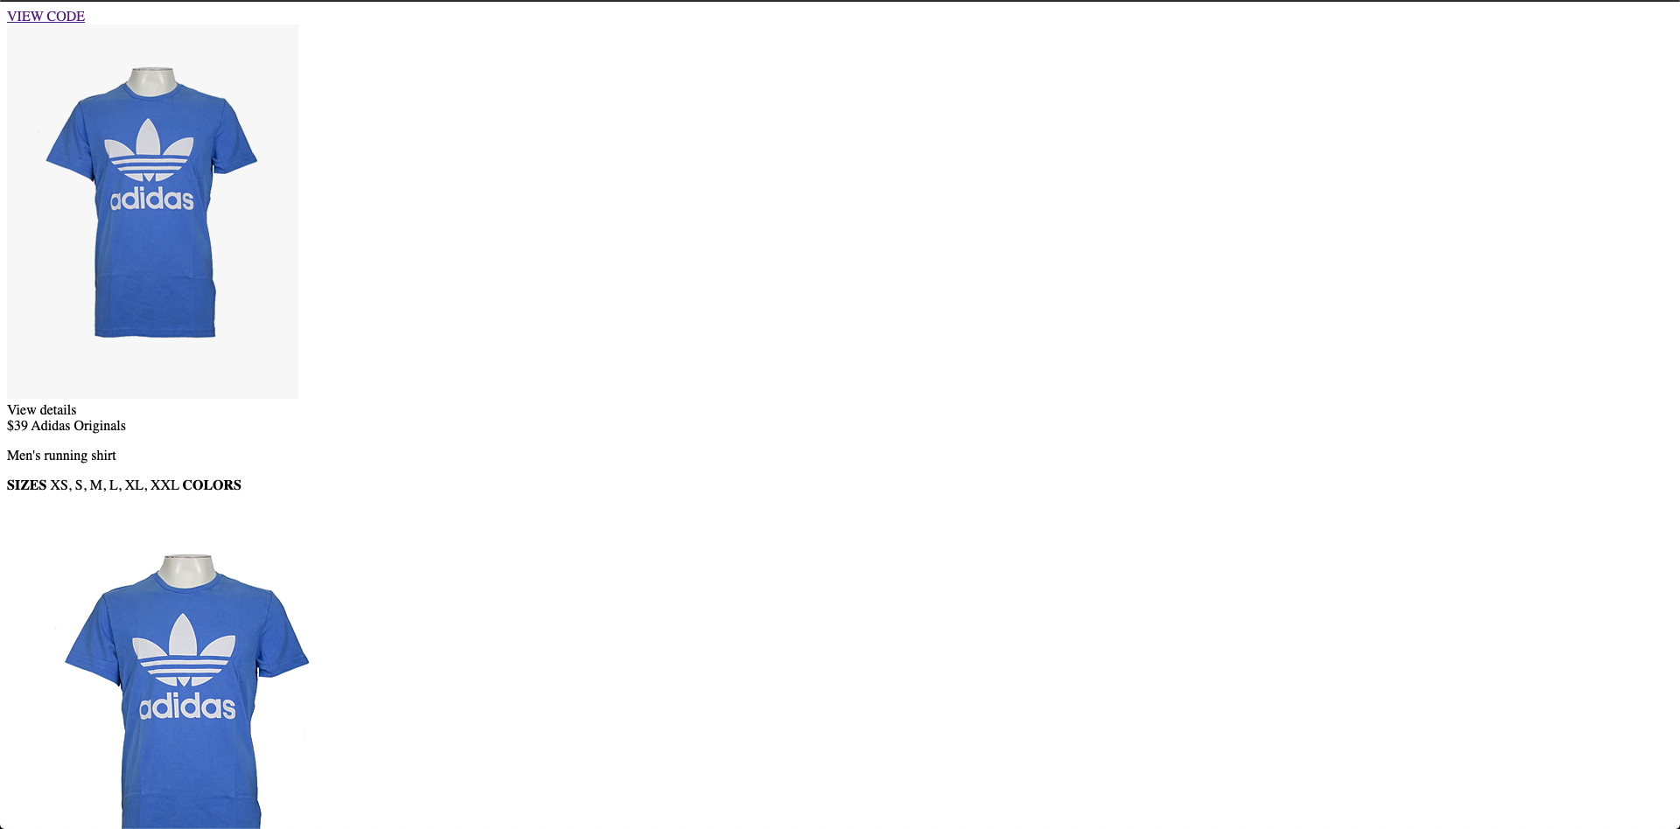
INTRO INTO CSS
What is CSS?
-CSS (Cascading Style Sheets) is a stylesheet language used to describe the presentation of a document written in HTML or XML.
-CSS describes how elements should be rendered on screen, in speech or in other media

Slide 19
ID VS CLASS

Slide 20
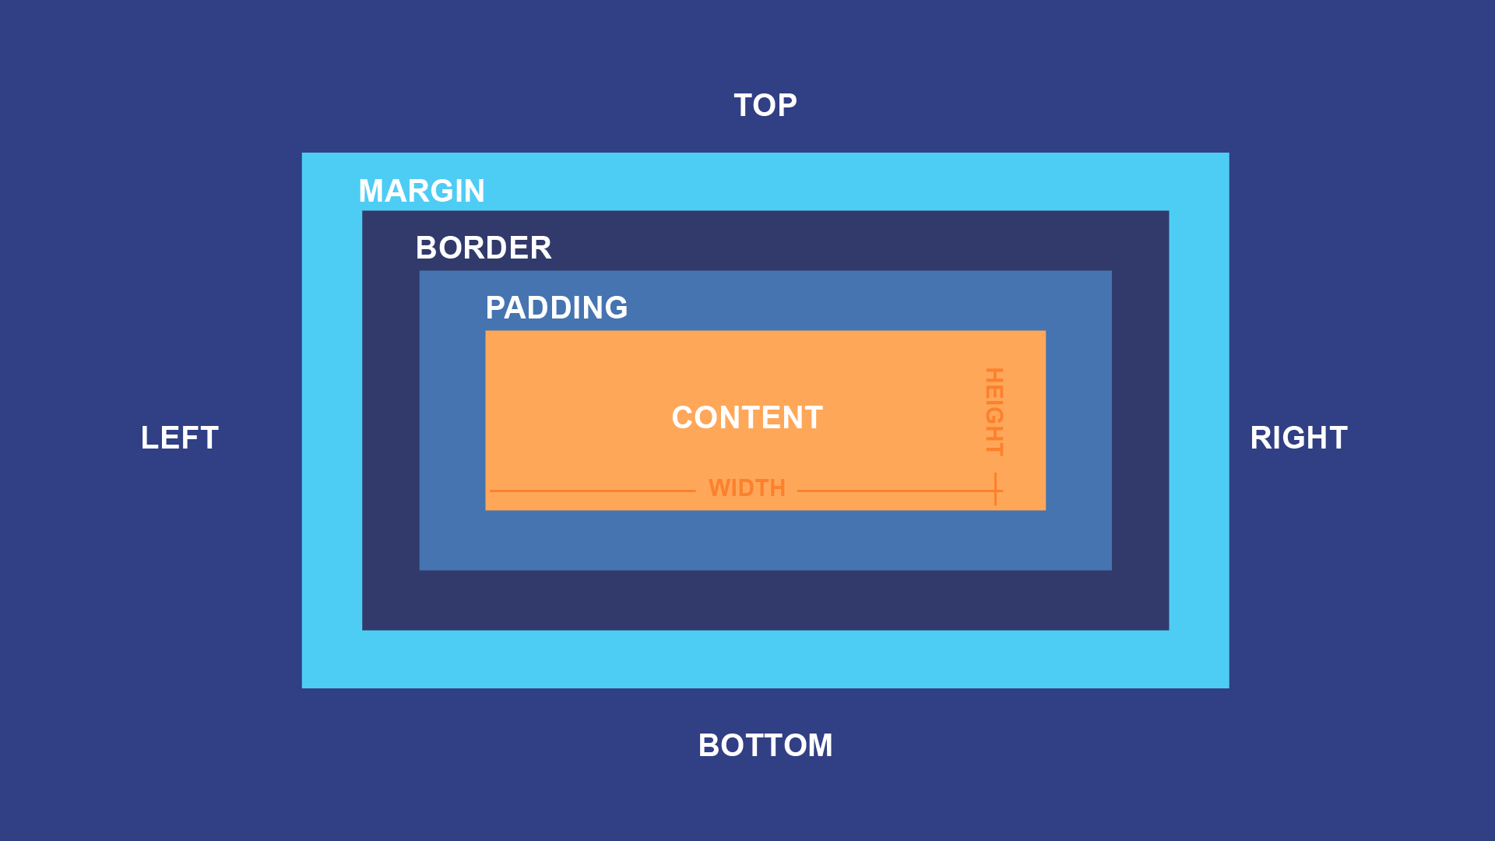
BOX MODEL
The term „box model” is used when talking about design and layout
A box that wraps around every HTML element
Members
Content – The content of the box
Padding – Clears an area around the content
Border – A border that goes around the padding and content
Margin – Clears an area outside the border

Slide 21
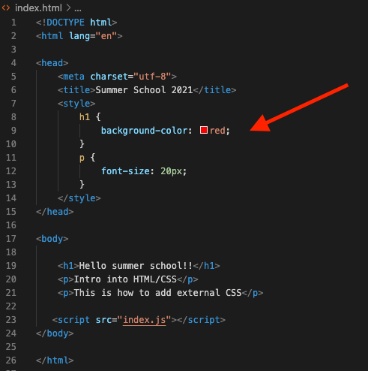
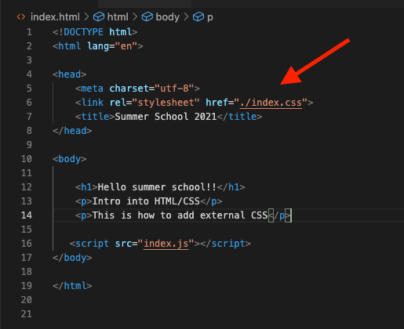
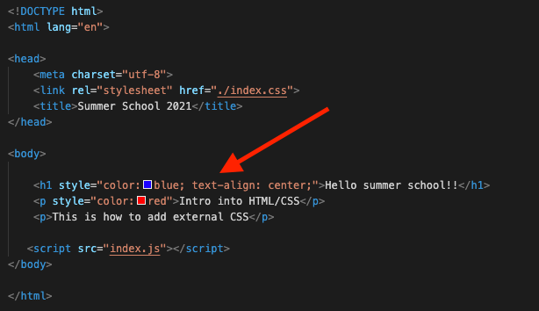
ADDING CSS?
We can add CSS in our web pages in 3 ways:
External CSS
Internal CSS
Inline CSS

Slide 22
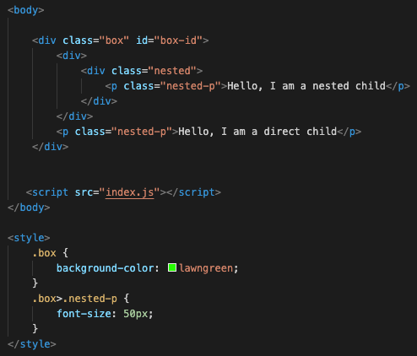
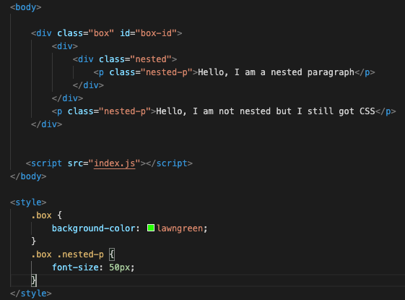
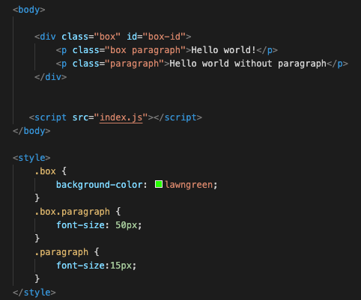
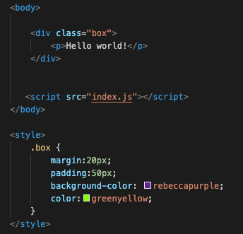
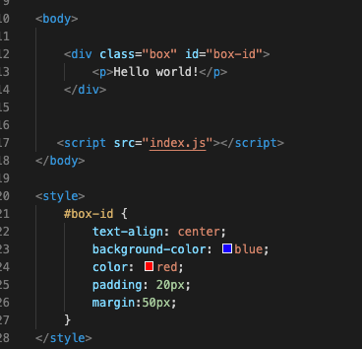

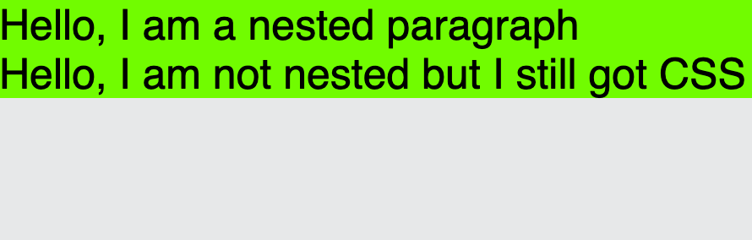



CSS Selectors
.class
Selects all elements with the same class
#id
Selects the element with the id
.class1.class2
Selects all the elements with both classnames in their class attributes
.class1 .class2
Selects all the elements where class2 is a descendant of a class1 element
.class1>.class2
Select all class2 elements where the parent is a class1 element

Slide 23
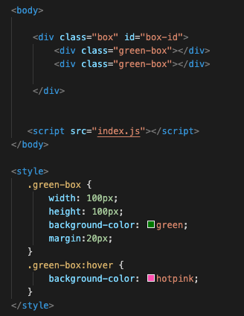
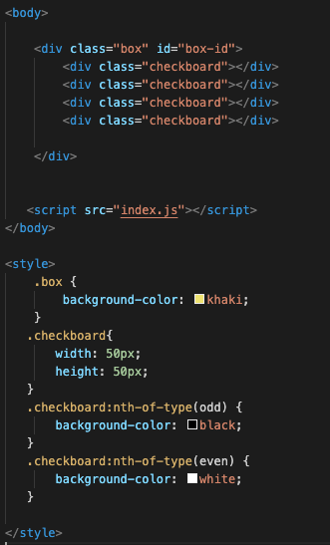


CSS Selectors #2
:hover
Selects elements on mouse hover
:nth-of-type(n)
Selects every elements that is the nth elements of its parent

Slide 24
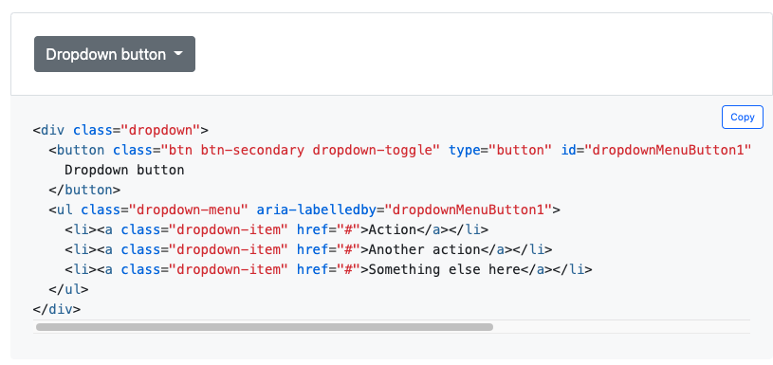
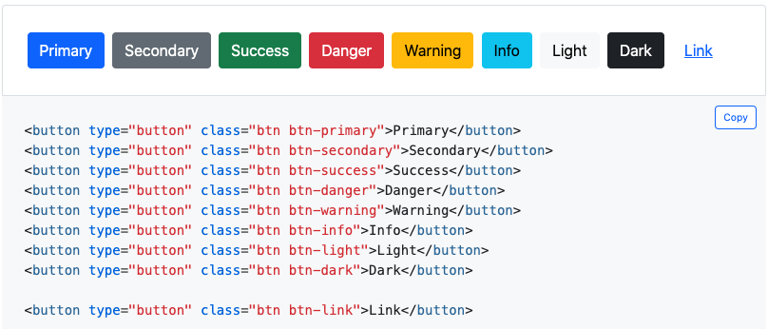
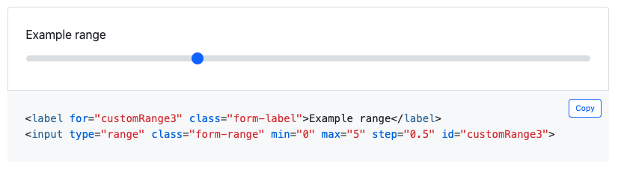
STYLING SYSTEMS - BOOTSTRAP
What is Bootstrap?
Free and open-source CSS framework
Contains CSS and Js based design templates for basically everything we need
Tenth most starred project on GitHub
Why do we need it?
Basically it makes our work easier

Slide 25
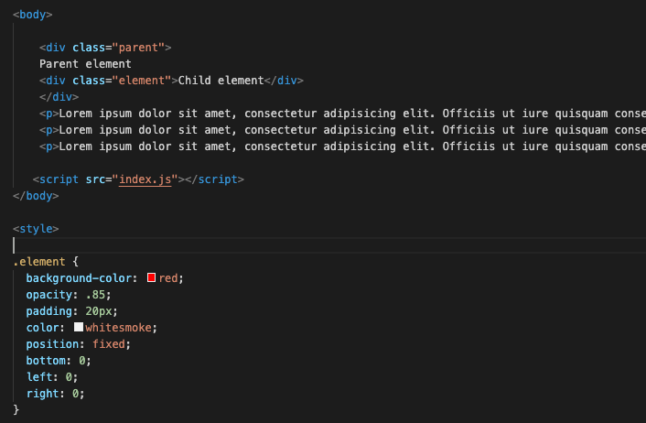
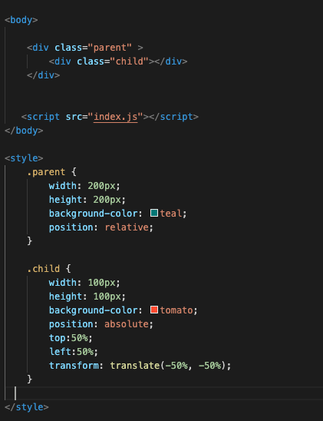
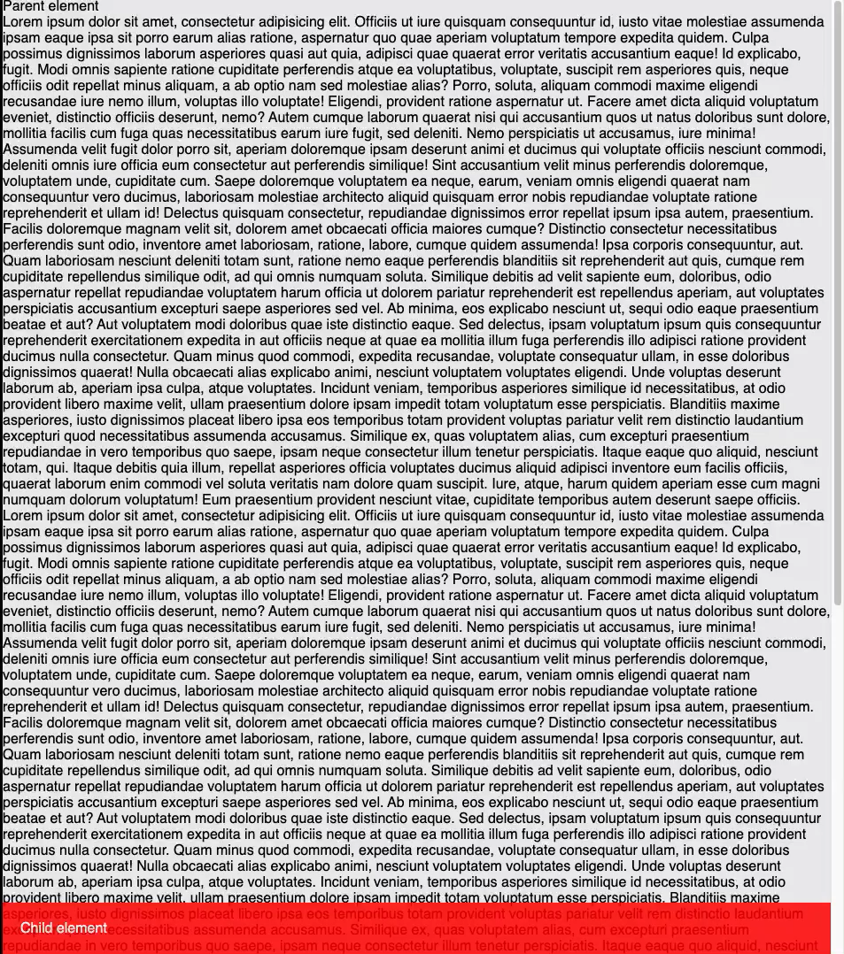
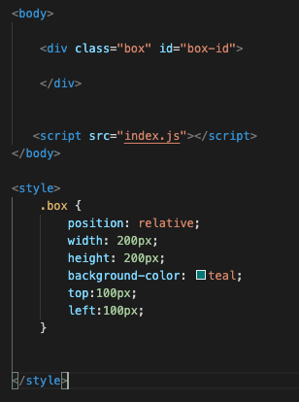
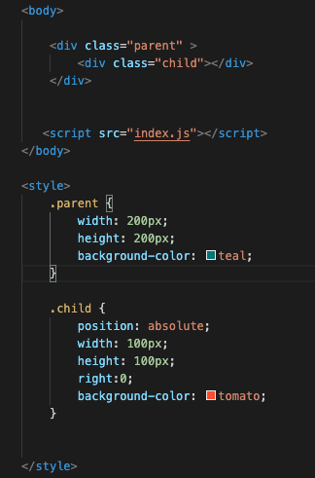





ELEMENTS POSITIONING
Position
Relative - Relative to its original position
Absolute – If it is on a child, the parent will behave as it doesn’t exist
Fixed - Similar to absolute, but not affected by scrolling
How do we center the content?

Slide 26
FLEXBOX
What is Flexbox?
A one-dimensional layout method for arranging items in rows or columns
How do we use it?
DEMO TIME

Slide 27

RESPONSIVE
Responsive?
Makes our pages look good on all devices
Uses only HTML and CSS
Units
Absolute
Px– Pixel
Pt– Point
Pc – Picas
In – Inch
Cm – Centimeter
Mm - Milimeter

Slide 28


RESPONSIVE #2
Units
Relative
Em – Relative to the font-size of the element
% - Relative to the parent element
Rem – Relative to the root element
Vw– Viewport width
Vh – Viewport height
Media Queries
CSS techinque introduced in CSS3.
@media rule to include CSS if a condition is true

Slide 29
W3Schools
CSS-TRICKS
LEARN MORE
https://www.w3schools.com/cssref/css_selectors.asp
Bootstrap
https://getbootstrap.com/
https://css-tricks.com/

Slide 30
04
CONCLUSION

Slide 31
Frequent interview questions
What’s the functionality of the „alt” attribute?
It specificies an alternate text, if the image cannot be displayed
What’s the difference between div and span?
Div is a block element, and span an inline one
Name some HTML5 tags
<header>,<article>,<main>
How can you add CSS style?
Internal, external, inline
What is the box-model?
A box that wraps around every HTML element
How do you center an element ? (2 examples)
Position: relative (parent), position:absolute, top:50%, left: 50%, translate(-50%,-50%)
Display: flex (parent), justify-content:center, align-items:center

Slide 32

ASSIGNMENT
To be continued after lunch…
___

Slide 33
THANKS!
Questions?

